Slide 1
Timeline of Disabilities in the United States
Helen T. Dainty, Ph.D., Laura Graves, Ph.D.,
Amy Locke-Callender, EdS.

Slide 2
This presentation will outline major events or laws that have had an impact on the history of special education in the United States. We will highlight our journey from seclusion to inclusion.

Slide 3
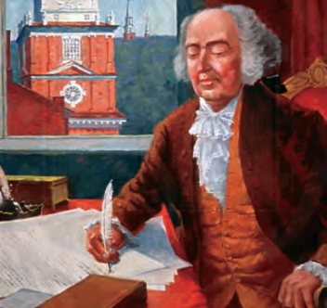
1798: First Military Disability Law
On July 16, 1798, United States President John Adams signed an act which addressed the relief of sick and disabled seamen.

Slide 4

1805
Dr. Benjamin Rush attempts to define mental disorders. Dr. Rush is considered the “Father of American Psychiatry.”

Slide 5
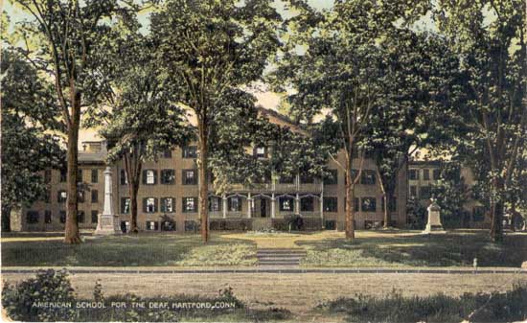
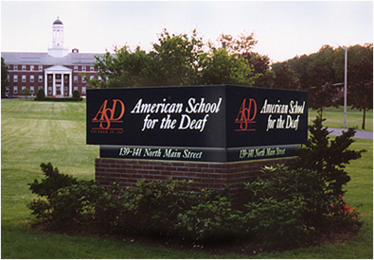
1817: Formal Deaf Education begins in United States
Thomas H. Gallaudet traveled to Europe to study deaf education. On April 17,1817, the Connecticut Asylum for the Education and Instruction of Deaf and Dumb Persons in Hartford, Connecticut was opened. This was the beginning of educating persons with disabilities in America.
Then
Now

Slide 6
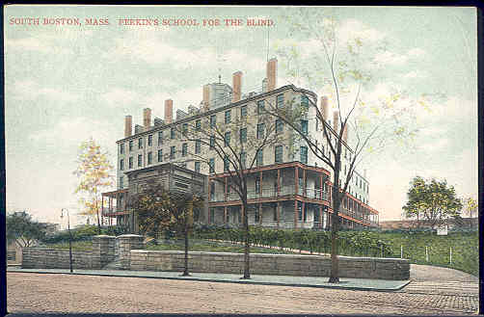

1849
The first “sheltered workshop” for the blind is known as the Perkins Institute, in Massachusetts. Today they serve persons who are blind on an International level.
Then
Now

Slide 7
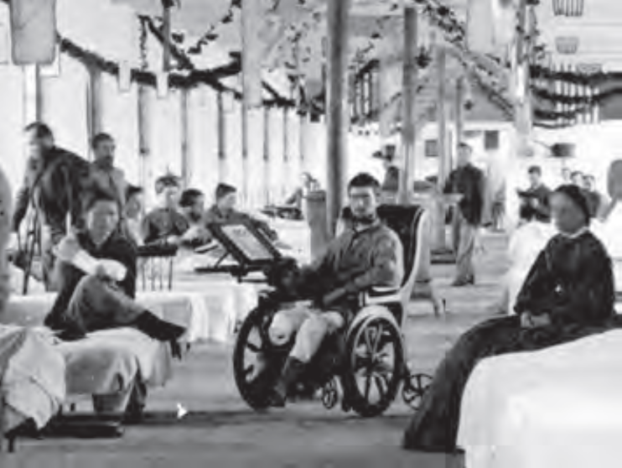
1861-1865: Civil War
After the Civil War there were about 30,000 men who loss a limb. This did bring disabilities to the consciousness of people in America.

Slide 8
1872: Invention of Telephone
Alexander Graham Bell invents the telephone and opens a school in Boston for teachers who are deaf.

Slide 9
1887
Helen Keller, who was deaf, dumb, and blind, had a home tutor known as Annie Sullivan. She lived in Alabama.

Slide 10
1901 & 1927
In 1901, Indiana becomes the first state, out of 24, to pass a eugenics law where “imbeciles, rapists and criminals” who were institutionalized were sterilized.
In 1927, the United States Supreme Court ruled that it is constitutional for mandatory sterilization of “mental defectives.”

Slide 11
1932
Franklin D. Roosevelt is elected as the 32nd President of the United States. He is paralyzed from the waist down and confined to a wheel chair. He helped to find the March of Dimes, formerly known as the National Foundation for Infantile Paralysis.

Slide 12
August 14, 1935
President Roosevelt signs the Social Security Act, a program which provides assistance to the disabled.

Slide 13
1950’s
The 1950s marked the beginning of looking at architecture and making buildings accessible to all.
The Association for Retarded Children (ARC) was founded by parents of children with mental retardation. Their main message was that persons with retardation have the ability to live a successful life. ARC worked to assure that the estimated 7 million citizens with mental retardation and other disabilities had the services and supports to live in communities.

Slide 14
1964
Civil Rights Act was passed in America. This act gave rights to persons of color and women, YET persons with disabilities were still discriminated against in terms of education, community and workplace.

Slide 15
1965
We are still at the Institution phase.
http://www.youtube.com/watch?v=k_sYn8DnlH4
Willowbrook finally closed in 1978 and residents are placed in community-based care

Slide 16


1968: First International Special Olympics
Special Olympics was founded in America by Eunice Kennedy Shriver, 1962. Persons with Intellectual Disabilities receive athletic training and are able to compete in Olympic type sporting events.
Russian athletes Ksenia Bodaleva, Ksenia Birullina, Stepan Bezrukow, Maria Lagunaya and Elena Perhunkova steal the show at Kazan 2013!

Slide 17
1973
In 1973, Section 504 of the Vocational Rehabilitation Act mandates that any federal agency and public agencies, receiving federal funds, are not allowed to discriminate based on disability.

Slide 18
Landmark Legislation
1975
Public Law 94-142
The Education for All Handicapped Children’s Act
mandated a free appropriate public education for all children with disabilities in the least restrictive environment, which meant public education.
This law was reauthorized in 1990, 1997, and 2004 and is now known as IDEA: The Individuals with Disabilities Education Act

Slide 19





1988
The Technology-Related Assistance for Individuals Act increased access and funding for assistive technology devices.

Slide 20
1990
The American with Disabilities Act becomes law under President George Bush. This act is considered the most important civil rights act since it brings advocates together to support all disabilities.

Slide 21


1990-2013
Trend towards Inclusion

Slide 22
Universal Design for Learners
http://www.udlcenter.org/resource_library/videos/udlcenter/udl#video0

Slide 23
Inclusive Settings
The trend in the United States is to have all children, regardless of ability or disability to be educated in the public school setting, PL 94-142 opened the school doors to all but still many were in self-contained classroom.
The demand, in past 2 decades, has been to include all students in the general education setting regardless of ability or disability and make teachers accountable for addressing the Common Core or State Standards when teaching all children.
The Individual Education Program (IEP) determines the amount of time a student is included and accommodations and modifications to be implemented to help meet standards.

Slide 24
IEP
The Individualized Education Plan (IEP) has several federally mandated components:
  Present levels of performance
  Measurable goals and objectives
  Statement about child’s participation in the least restrictive environment
  Dates of the initial and duration of services
  Non-discriminating assessment procedures
  Accommodations and modifications on tests and in general education program
  Transition planning for secondary and post-secondary education.

Slide 25

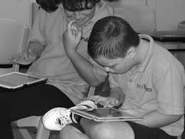




Inclusion in P12 Schools
Google for Images

Slide 26
Even at Tennessee Technological University (TTU) students with disabilities are included but it is recommended that they register with the Office of Disability Services, located on campus.
These students may have a learning disability or ADD/ADHD.
However…

Slide 27
Remember the Independence Program!
Through a partnership with TTU and the Putnam County School District, several students with intellectual disabilities are welcomed to participate in activities on campus.

Slide 28
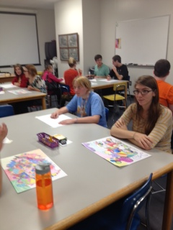
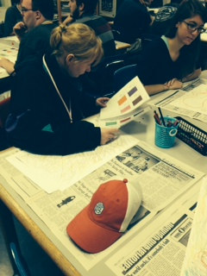
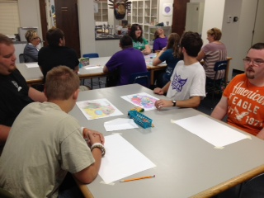
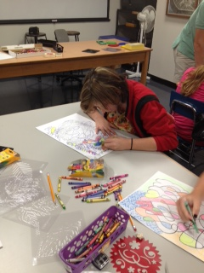
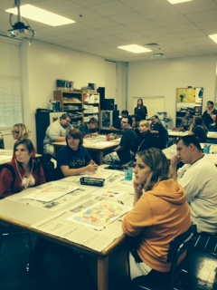
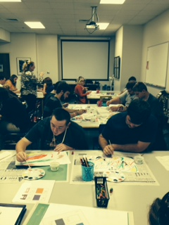
Included in MUED/ARED 4882

Slide 29
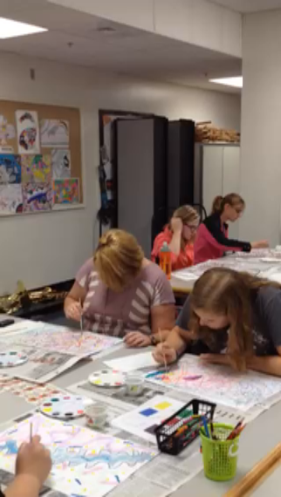
Video Of Independence Program and TTU Music/Art Students
Working Side-by-Side

Slide 30
http://www.youtube.com/watch?v=GfUqd1fTtgM

Slide 31
References
Disability History:
www.ncld-youth.info
Inclusion in Education:
http://www.youtube.com/watch?v=GfUqd1fTtgM
Universal Design Website:
http://www.udlcenter.org/resource_library/videos/udlcenter/udl#video0
Willowbrook:
http://www.youtube.com/watch?v=k_sYn8DnlH4

